Slide 1
Data Professionals Survey Analysis
Insights from 630 Data Industry Professionals
Venkata Akhil Mettu
December 08th, 2024

Slide 2
Executive Summary
Introduction
This analysis explores insights from a survey of 630 data professionals, examining their demographics, career paths, job satisfaction, and preferred technologies. The project utilizes Power BI dashboards to visualize key trends and patterns in the data industry.
Survey Overview:
630 Total Respondents.
Average Age: 29.87 years.
Global Representation.
Focus on Career Paths, Satisfaction, and Skills.

Slide 3
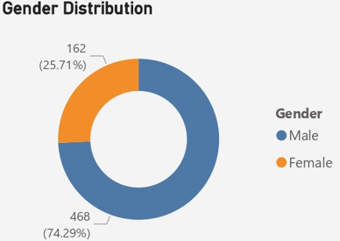
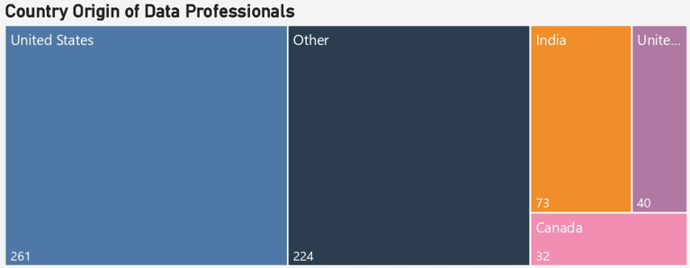
Demographics Overview
Gender Distribution:
Male: 74.29% (468).
Female: 25.71% (162).
Geographic Spread:
United States (261).
Other (224).
India (73).
United Kingdom (40).
Canada (32).

Slide 4
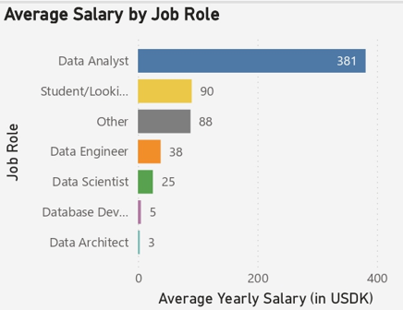
Job Roles Distribution
Key Statistics:
Data Analysts: 381 professionals.
Students/Looking: 90.
Data Engineers: 38.
Data Scientists: 25.
Database Developers: 5.
Data Architects: 3.

Slide 5
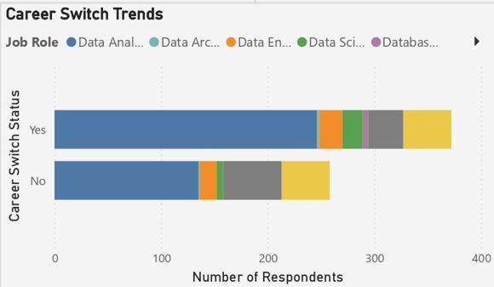
Career Path Analysis
Breaking into Data:
Neither Easy nor Difficult: 42.7%
Difficult/Very Difficult: 31.7%
Easy/Very Easy: 25.6%
Career Transition Trends
High transition rate into Data Analyst roles.
Significant career switching across all roles.

Slide 6
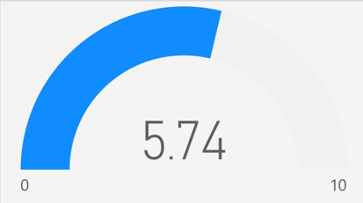
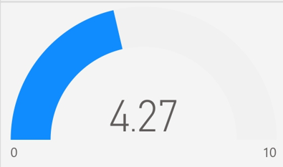
Job Satisfaction Metrics
Work/Life Balance Score: 5.74/10
Salary Satisfaction Score: 4.27/10
Learning Satisfaction Distribution
Highest satisfaction: 83 respondents (10/10).
Strong middle range: 6-7 ratings.

Slide 7
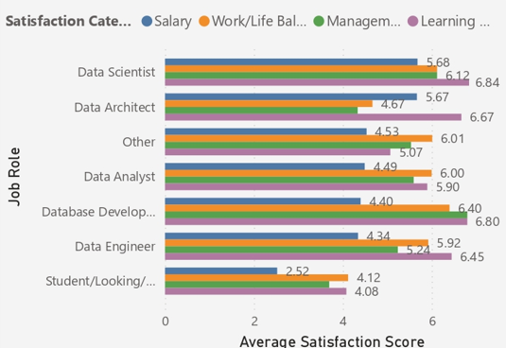
Role-Based Satisfaction
Satisfaction Scores by Role:
Data Scientists:
Highest overall satisfaction.
Strong learning opportunities (6.84).
Data Architects:
Strong work/life balance.
Good management scores.
Data Analysts:
Moderate satisfaction levels.
Room for improvement in salary satisfaction.

Slide 8
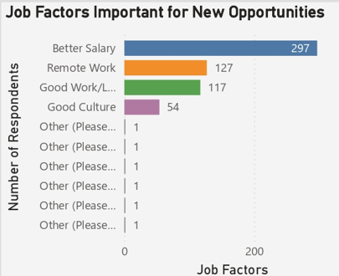
Professional Priorities
Top Priorities for New Opportunities:
Better Salary (297 responses).
Remote Work (127 responses).
Good Work/Life Balance (117 responses).
Good Culture (54 responses).

Slide 9
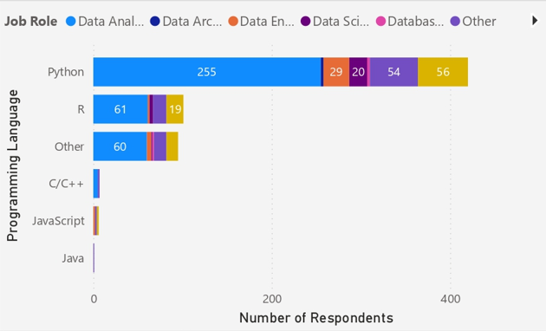
Programming Languages
Most Popular Languages:
Python (255 users).
R (61 users).
Other (60 users).
C/C++ (29 users).
JavaScript (20 users).
Java (19 users).

Slide 10
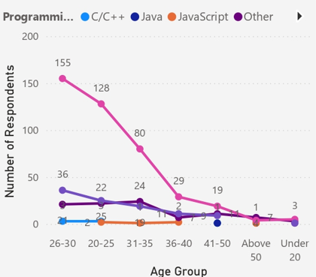
Age and Technology Trends
Key Observations:
Python dominance in 20-30 age group.
More diverse technology stack in 31+ age group.
Clear preference patterns by age segment.

Slide 11
Key Insights
1. Industry Demographics:
Young workforce (avg. 29.87 years).
Male-dominated field (74.29%).
Strong US presence.
2. Career Trends:
Data Analyst as dominant role.
Moderate entry barriers.
Active career switching.
3. Satisfaction Metrics:
Good work/life balance.
Lower salary satisfaction.
Strong learning opportunities.

Slide 12
Recommendations
1. For Employers:
Address salary satisfaction gap.
Maintain flexible work options.
Continue strong learning programs.
2. For Professionals:
Focus on Python proficiency.
Consider Data Analyst as entry point.
Leverage learning opportunities.

Slide 13
Future Outlook
Growing importance of Python.
Emphasis on work/life balance.
Continued career switching opportunities.
Focus on remote work options.

Slide 14
Thank You

